Slide 1
UNIT-IV - FAI Decision Tree-ID3 Algorithm

Slide 2
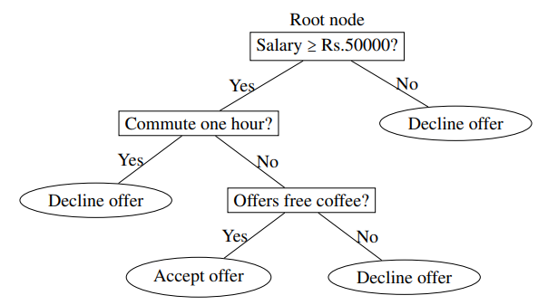
Decision Tree- Introduction
A tree is defined as an undirected graph in which any two vertices are connected by exactly one path.
Decision tree is a graph-theoretical tree, all terminology related to graph-theoretical trees can be applied to describe decision trees also.
For example, the nodes or vertices shown as ellipses are called the leaf nodes. All other nodes, except the root node, are called the internal nodes.

Slide 3
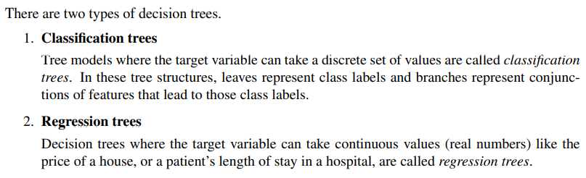
Decision tree builds classification or regression models in the form of a tree structure. It breaks down a dataset into smaller and smaller subsets while at the same time an associated decision tree is incrementally developed. The final result is a tree with decision nodes and leaf nodes.

Slide 4
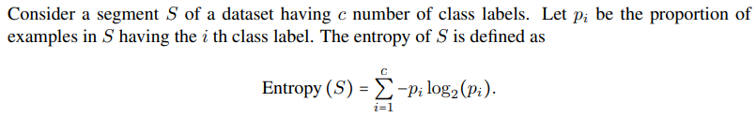
Basic concepts: Entropy
Entropy is an information theory metric that measures the impurity or uncertainty in a group of observations. It determines how a decision tree chooses to split data.
The value of entropy varies from 0 to 1
Entropy = 1 : Purity: Data set good for learning – possible 50% yes, 50% No
Entropy =0: No impurity: not good for learning

Slide 5
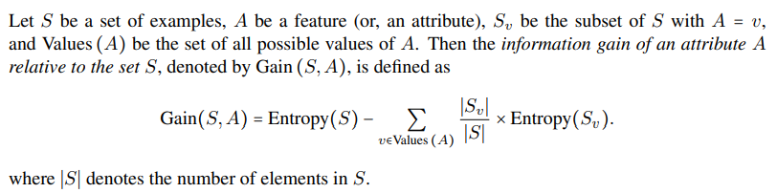
Basic concepts: Information Gain
We can define information gain as a measure of how much information a feature provides about a class. Information gain helps to determine the order of attributes in the nodes of a decision tree.
The main node is referred to as the parent node, whereas sub-nodes are known as child nodes. We can use information gain to determine how good the splitting of nodes in a decision tree.

Slide 6
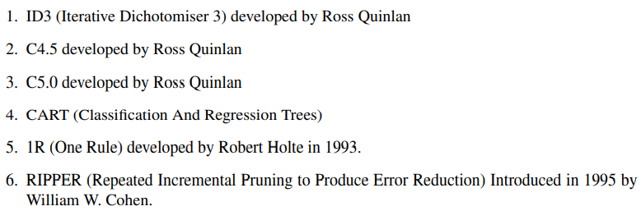
Types of Decision Tree Algorithms

Slide 7
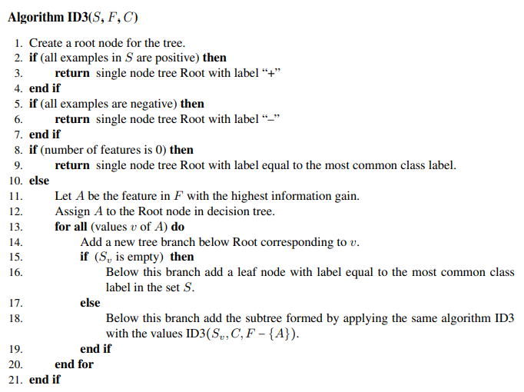
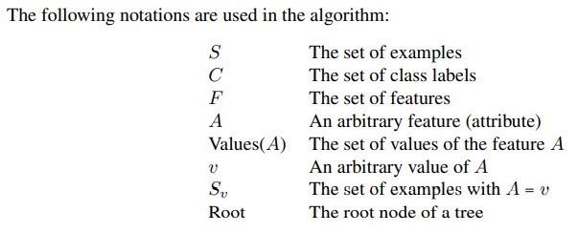
ID3 Algorithm:

Slide 8
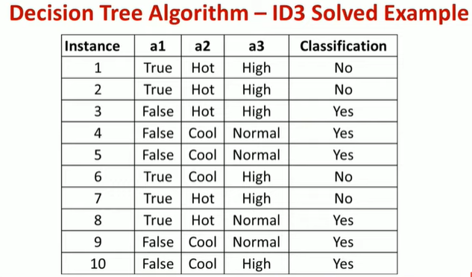

Slide 9
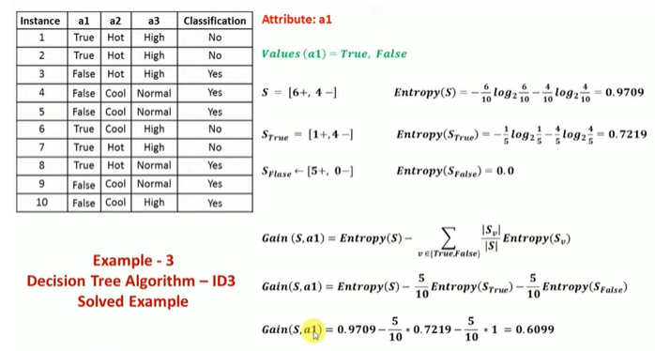

Slide 10
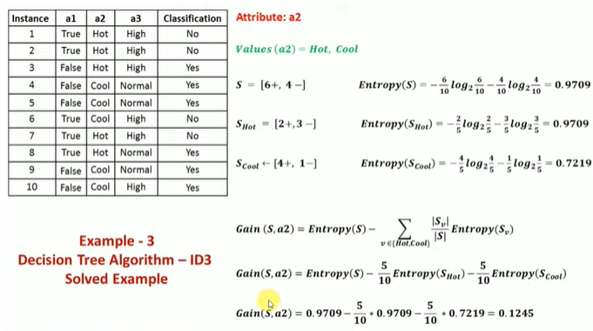

Slide 11
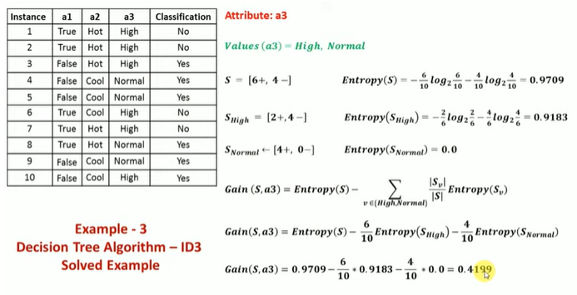

Slide 12
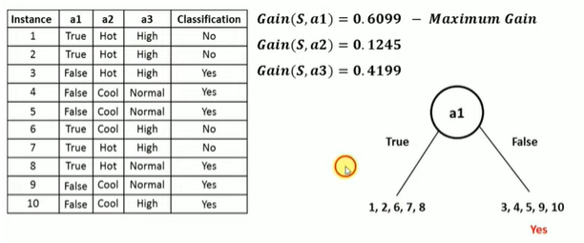

Slide 13
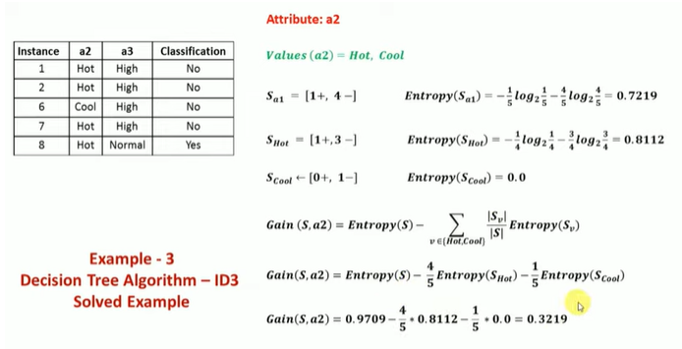

Slide 14
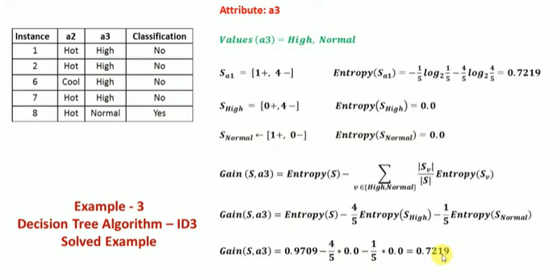

Slide 15
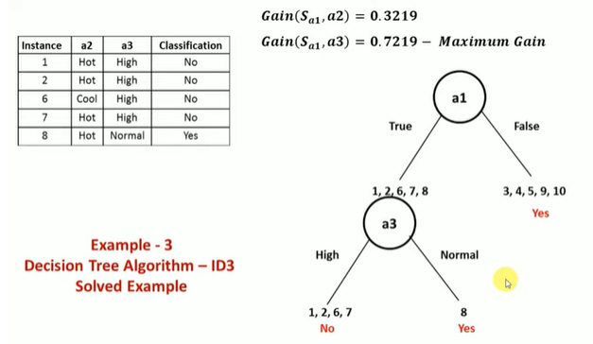

Slide 16
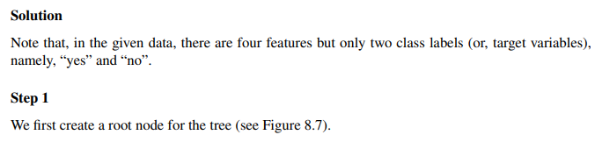
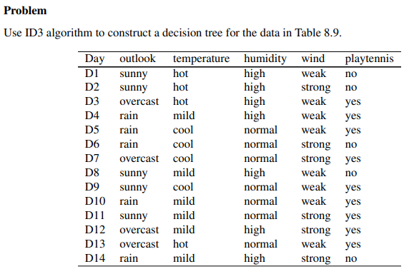
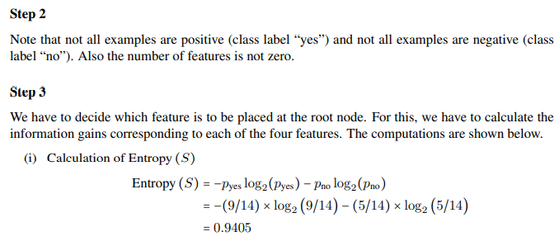
Problem 2:

Slide 17
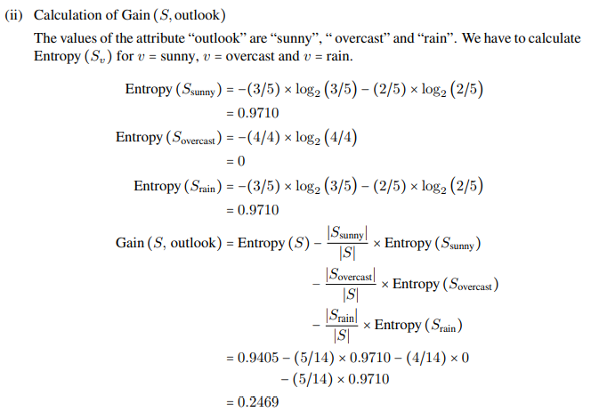

Slide 18
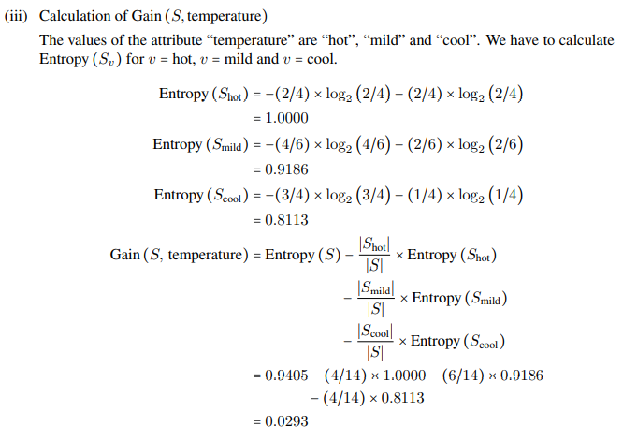

Slide 19
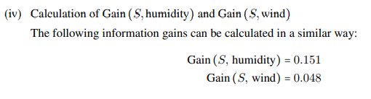
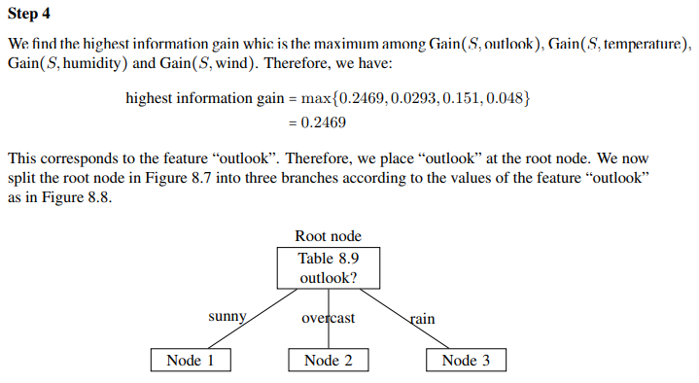
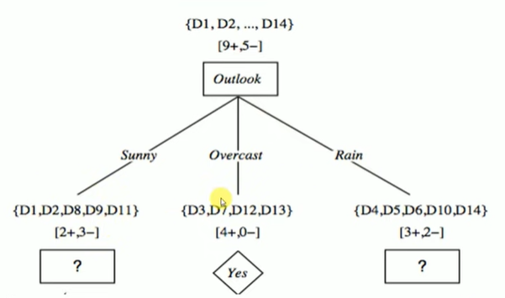

Slide 20
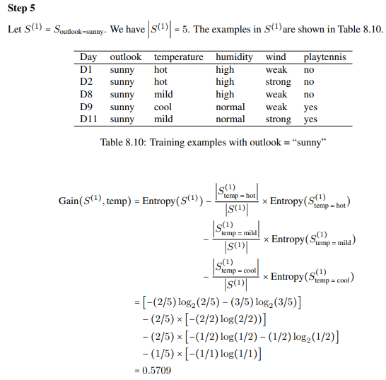

Slide 21
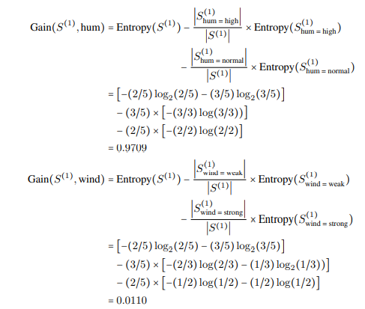

Slide 22
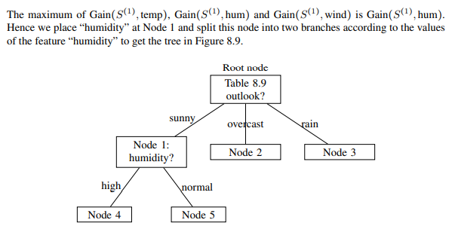
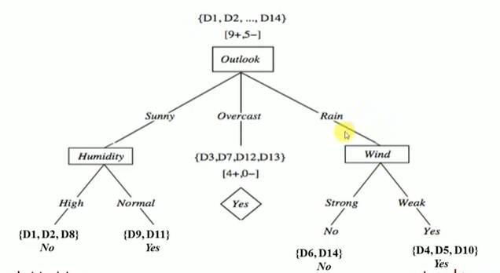

Slide 23
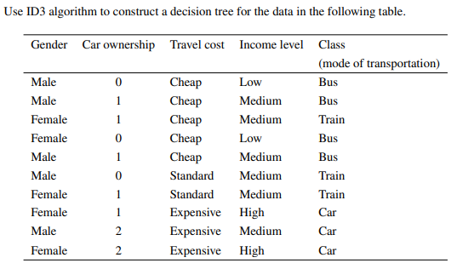
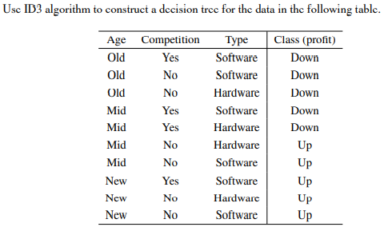
Exercises:

